Slide 1


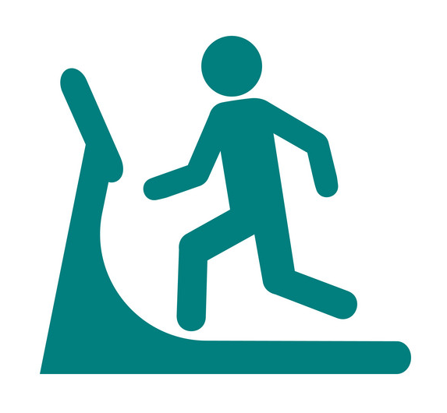



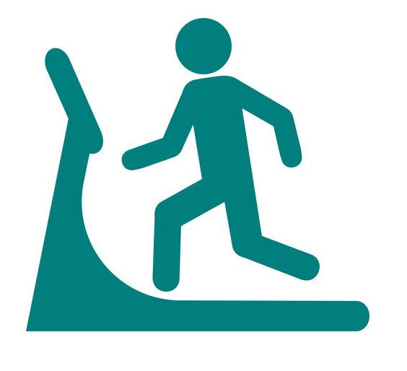


For people who use the app when they are not in the gym
WHY NOT BOOK A CLASS?
You have no booked classes
Search for Classes >
COVENTRY SKYDOME
TODAY
0
91
PEOPLE CURRENTLY IN THE GYM
OF THOSE ARE IN CLASSES
WEIGHT UP
Equipment being used >
VISITS
AVG DURATION
ACTIVITY
CLASSES
12
2h
16m
0
HOME
CLASSES
ACTIVITY
WEIGHT UP
WORKOUTS
ACCOUNT

Slide 2



COVENTRY SKYDOME
Equipment's In Use
FULL BODY MACHINES
FREE WEIGHTS
UPPER BODY MACHINES
HOME
CLASSES
ACTIVITY
WEIGHT UP
WORKOUTS
ACCOUNT

Slide 3
FULL BODY MACHINES
FULL BODY MACHINES
Ping
Treadmill
20 in-use 4 available 1 out of
service
Ping
Rowing
4 in-use 0 available 0 out of
service
Ping
Cycle
16 in-use 5 available 3 out of
service
Ping
HOME
CLASSES
ACTIVITY
WEIGHT UP
WORKOUTS
ACCOUNT

Slide 4
FULL BODY MACHINES
UPPER BODY MACHINES
Bench Press
4 in-use 1 available 0 out of
service
Ping
Lat Pulldown
2 in-use 1 available 1 out of
service
Ping
Peck Deck
0 in-use 2 available 0 out of
service
Ping
HOME
CLASSES
ACTIVITY
WEIGHT UP
WORKOUTS
ACCOUNT

Slide 5
FULL BODY MACHINES
FREE WEIGHTS
8kg Dumbbell
2 in-use 1 available 0 out of
service
Ping
4kg Dumbbell
2 in-use 1 available 1 out of
service
Ping
Curl Bar
0 in-use 2 available 0 out of
service
Ping
HOME
CLASSES
ACTIVITY
WEIGHT UP
WORKOUTS
ACCOUNT

Slide 6

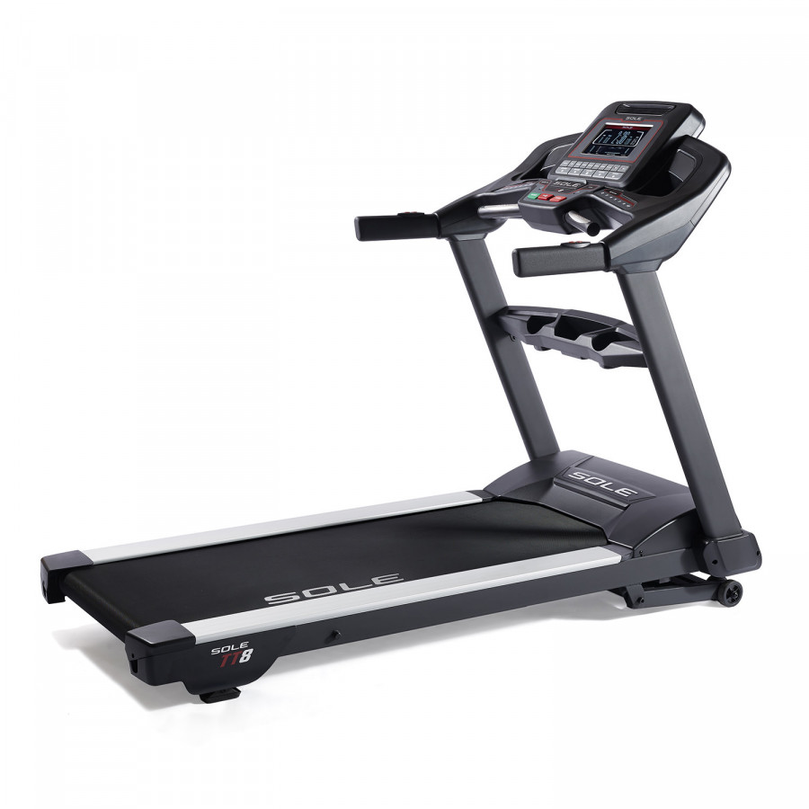
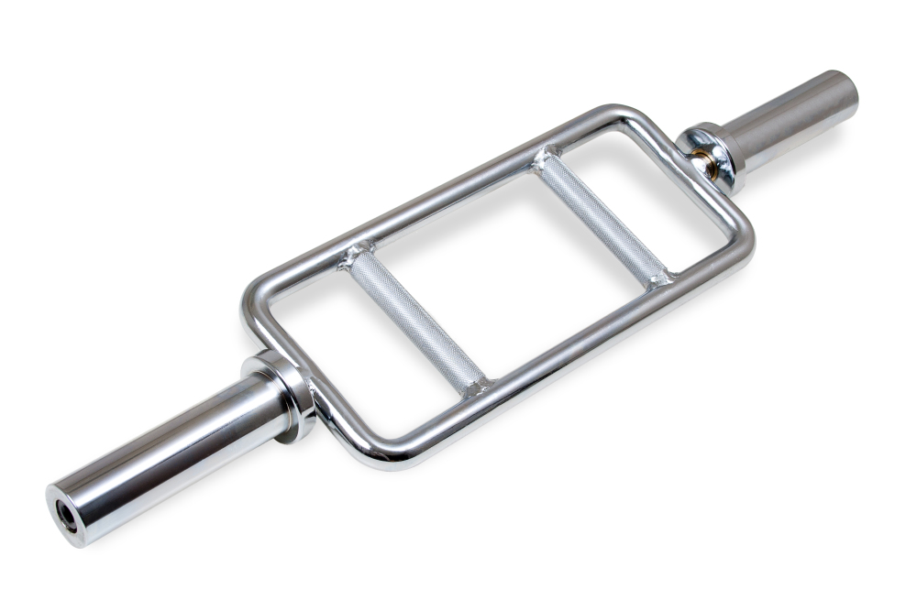
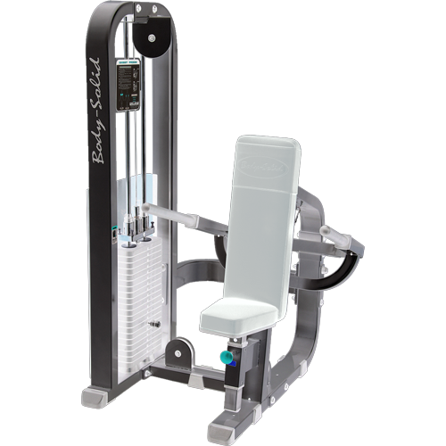
COVENTRY SKYDOME
Equipment's In Use
Treadmill
5
PEOPLE CURRENTLY IN QUEUE
Queue me
Triceps Bar
0
PEOPLE CURRENTLY IN QUEUE
Queue me
Triceps Press
2
PEOPLE CURRENTLY IN QUEUE
Queue me
HOME
CLASSES
ACTIVITY
WEIGHT UP
WORKOUTS
ACCOUNT

Slide 7
COVENTRY SKYDOME
Equipment's In Use
Treadmill
5
PEOPLE CURRENTLY IN QUEUE
Queue me
Triceps Bar
Sorry you need to be in the Gym to be Queued
0
PEOPLE CURRENTLY IN QUEUE
Queue me
Triceps Press
2
PEOPLE CURRENTLY IN QUEUE
Queue me
HOME
CLASSES
ACTIVITY
WEIGHT UP
WORKOUTS
ACCOUNT

Slide 8
COVENTRY SKYDOME
Equipment's In Use
Treadmill
5
PEOPLE CURRENTLY IN QUEUE
Queue me
Triceps Bar
0
PEOPLE CURRENTLY IN QUEUE
Queue me
Triceps Press
2
PEOPLE CURRENTLY IN QUEUE
Queue me
HOME
CLASSES
ACTIVITY
WEIGHT UP
WORKOUTS
ACCOUNT

